Slide 1
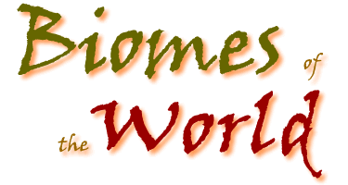
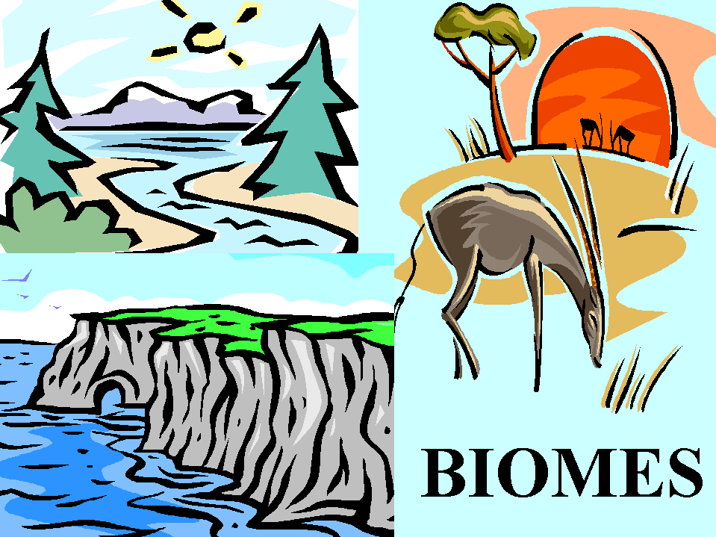
By Mrs. Nelson’s 3rd Grade

Slide 2
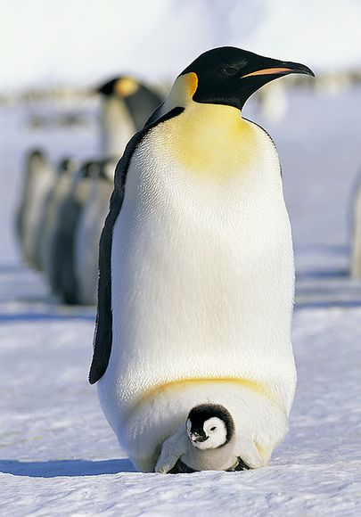
Fun Facts!
There are snakes underwater. The southern ocean is located around the south pole which is home of the emperor peguin.

Slide 3
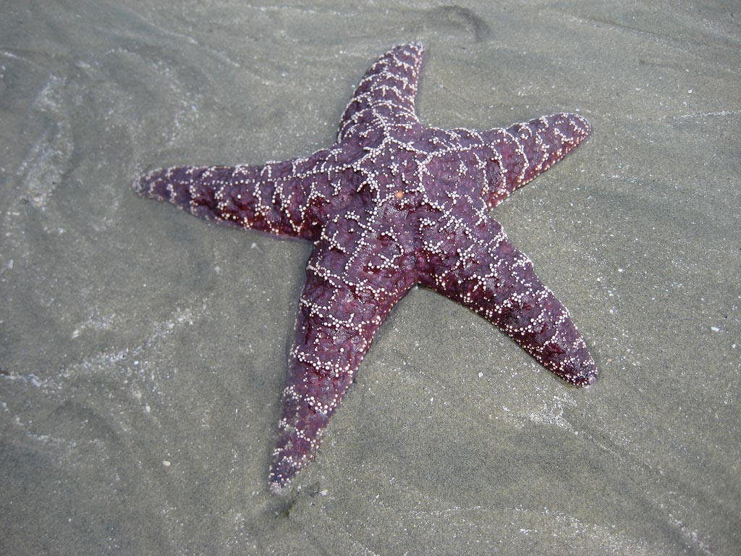
Animal life
A starfish lives in a coral reef, and eats mollusks, such as clams, oysters, and mussels

Slide 4
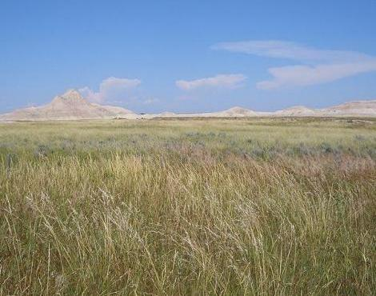
Grasslands
Grasslands are large open areas. Some grasslands have short grasses. Tropical grasslands are often called savannas. Africa, India, Southeast Asia, Brazil, and Australia all have tropical grasslands.

Slide 5
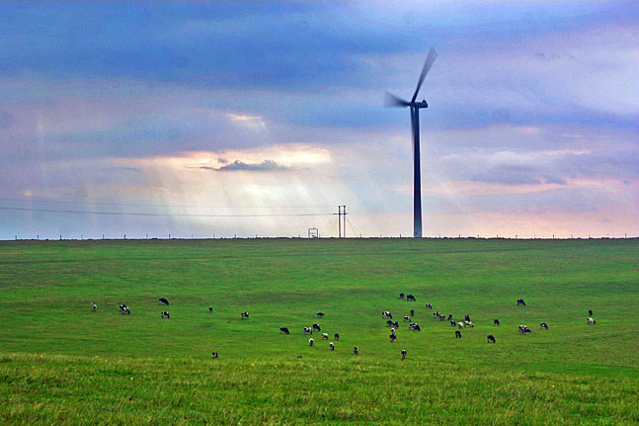
Prairie and savannas are types of grasslands. Grasslands are large open areas. Grasslands often have grass there is a wet and dry season.

Slide 6
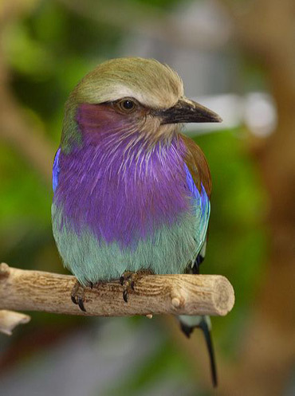
Animals
Prairie chickens eat mostly leaves and seeds and in the summer they eat abundant insects.

Slide 7
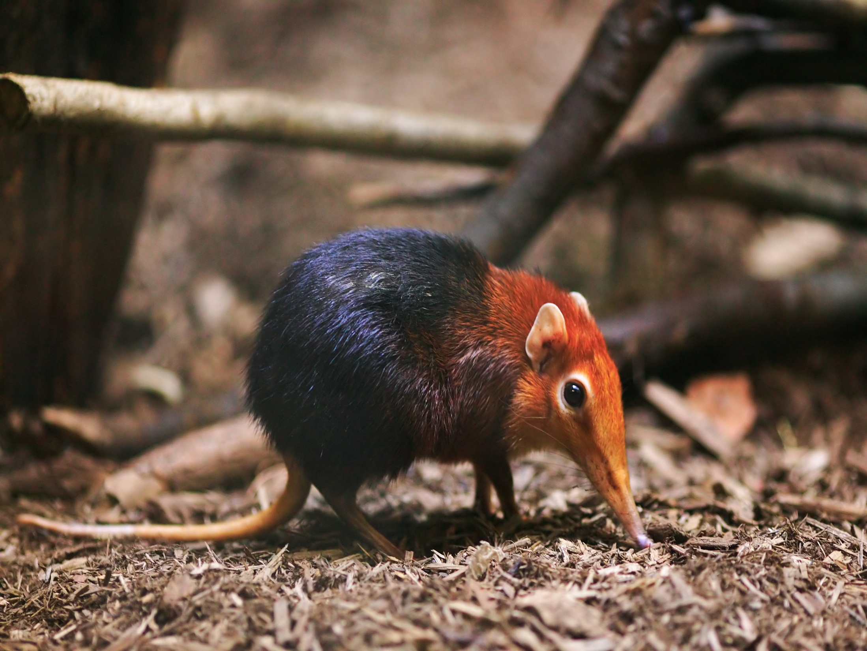
Forest Animals
Shrew’s have to eat half their weight in grubs, worms and insects each day in the winter to survive.

Slide 8
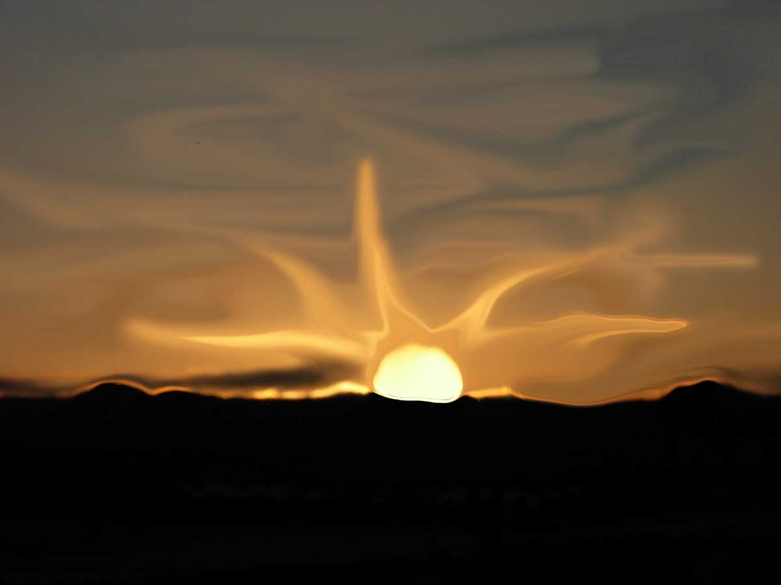
DESERT
A desert is a region where the soil is so dry that very few plants can grow. Deserts
are on every continent. Deserts do not have a lot of rain.

Slide 9
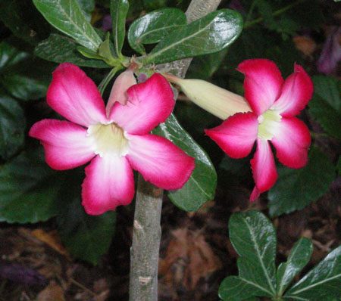
Plants ☺
A little bit of plants grow in deserts during dry periods. Some have long roots and get water from deep underground. Others store water in their roots.

Slide 10
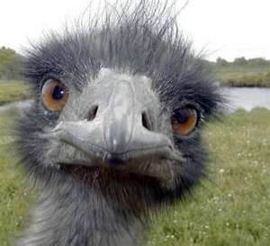
animals
Lots of bugs and spiders live in the desert with lizards and rats. Ostriches have long legs to keep their body's off the hot sand.

Slide 11
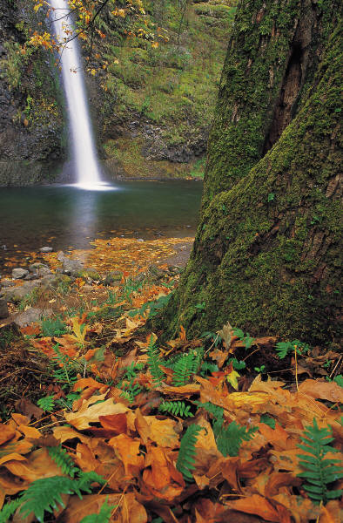
Fun facts
Tree rings provide a record for clues about climate conditions. During hibernation lunar moths heart rate drops so that they do not use their stored energy too quickly.

Slide 12
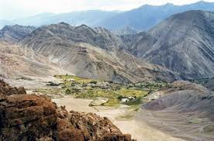
Introduction ☺
My biome is the Tundra. It is a barren region with no trees because the winters are long and cold and the summers are short. The Tundra is located at the top of the world near the north pole. Temperatures can dip to about -60 f.

Slide 13
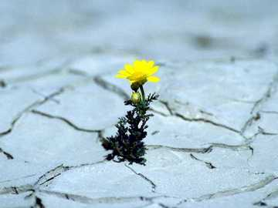
Plants
Certain plants live in the tundra. Small growing plants like moss, lichen, grasses and a grass like plant called sedges.
One of the food reindeer eat is sedges.

Slide 14
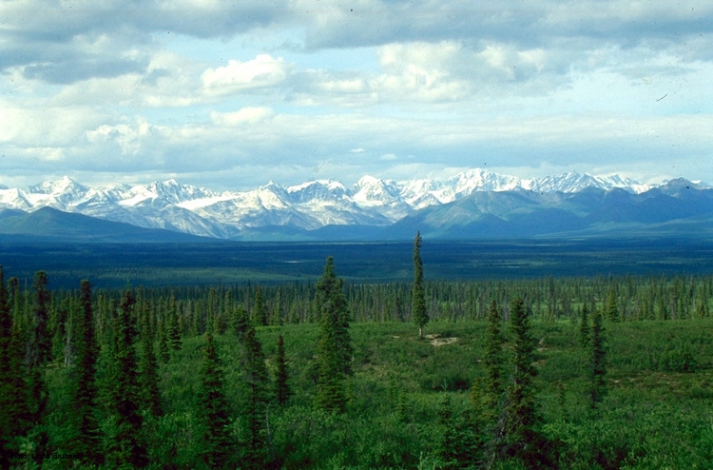
TAIGA
Another name for Taiga is boreal. Many lakes and bogs are found in the Taiga. Its
very cold in the summer.

Slide 15
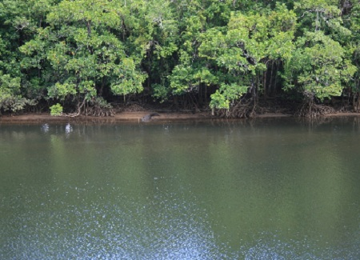
Plant life
Bamboo is one of the many useful products from the rainforest.

